Slide 1
Team 5:
Multidisciplinary Optimization –
Formulations and Mehtods
Alex Beyer, Ella Vincente
Department of Mechanical Engineering
University of Maryland
College Park, MD 20742-3035
Email: {abeyer, gvincente}@umd.edu

Slide 2
Multidisciplinary Motivations
Many common problems involve optimizing across different fields
Structure Design
Economics
Robotics & Controls
How do we optimize these problems if they involve information and constraints across multiple distinct fields?
How do we solve simpler problems?
Notes:
Optimization problems are a common feature of many different branches of science
However, oftentimes we find ourselves having to optimize across multiple domains at once, for example:
Structure Design often involves optimizing for everything from mechanical properties of building materials and environmental impact to the economics of the project
Many robotics problems require multiple systems interacting to solve problems while trying to optimize for things like speed, power consumption and accuracy
BUT – how do we handle solving these disparate problems separately? In many cases we end up with multiple distinct sets of equations, all with unique constraints, which only share some of their variables. The naïve approach is to try and extend methods we’ve used before for simpler problems, however this becomes incredibly difficult as the number of variables and constraints increases. In practice this means we need to approach these problems carefully, breaking them down in ways that make the optimization easier – this is where multidisciplinary optimization comes in!

Slide 3
1st-Half Project Topics
~~~PROBLEM FORMULATION PAPER HERE?~~~

Slide 4
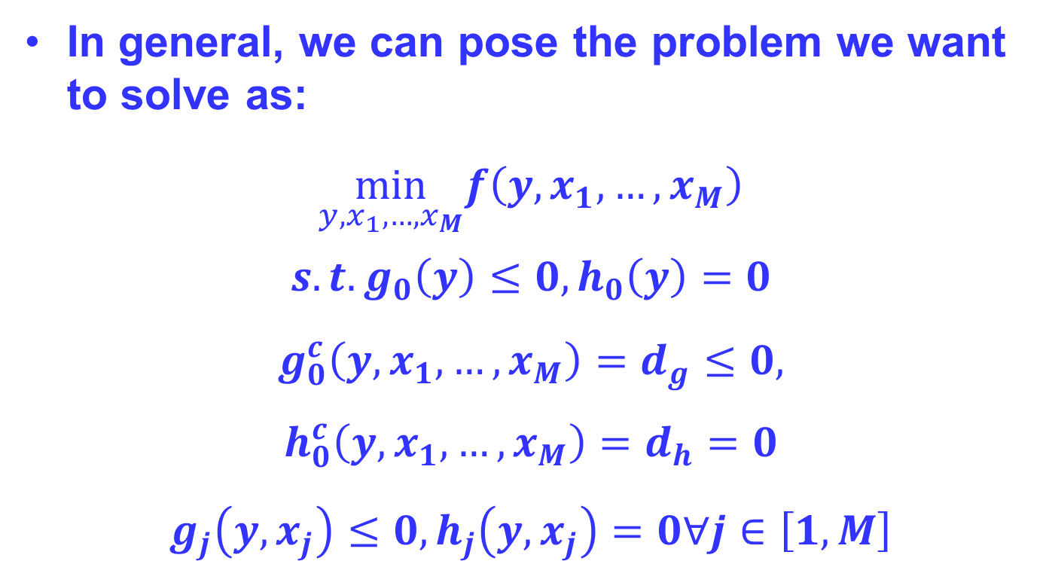
MDO: Problem Statement
In general, we can pose the problem we want to solve as:
$$\min_{y,x_{1},…,x_{M}}f\left(y,x_{1},…,x_{M}\right)$$
$$s.t. g_{0}\left(y\right)≤0, h_{0}\left(y\right)=0 \\ g_{0}^{c}\left(y,x_{1},…,x_{M}\right)=d_{g}≤0, \\ h_{0}^{c}\left(y,x_{1},…,x_{M}\right)=d_{h}=0 \\ g_{j}\left(y,x_{j}\right)≤0, h_{j}\left(y,x_{j}\right)=0∀j∈\left[1,M\right]$$
System Constraints
Consistency Constraints
Disciplinary Constraints
Notes:
Before we can start classifying problems and discussing approaches it’s helpful for us to determine a standard form to pose these problems
Our goal is to minimize a set of functions f which depends on the system level variables y and may depend on some or all of the disciplinary variables x1,…,M
In general, we can split our constraint functions into two types: inequality based (g) and equality based (h)
And further split them into three types: system level constraints which depend only on system level constraints, consistency constraints which ensure that optimizing one domain doesn’t lead to infeasible solutions in another domain and can depend on any variables in the problem, and finally the disciplinary constraints which are functions of only variables in that discipline and the system level constraints
A few notes:
1 - All the functions f, g and h are vector valued
2 – in some cases we refer to the value of the consistency constraints as the discrepency d
3 – If you read the papers (which I suggest you do if you do MDO) some of them make a distinction between the disciplinary state variables which are not optimized, s, and disciplinary design variables which are, x. In this presentation we combine both into the vector xj
4 – functions are variables subscripted with a zero are system level, while nonzero subscripts refer to the discipline the function is a part of

Slide 5
MDO: Problem Statement
Introduce example here?

Slide 6
MDO: Solver Setup
Before setting up an optimizer we need to decide on an approach:
Do we solve the problem all at once or break it into smaller problems?
How do we optimize system level variables?
How do we optimize discipline specific variables?
Notes:
Once we have our problem in standard form we still need to figure out how we want to solve it
In some cases it makes sense to treat our multidisciplinary problem as a monolith and try to solve it all at once, while in others we might want a more nuanced approach where we dicide the problem into parts and solve separately
We also need to make decisions about how to treat system level variables and variables which only appear in one discipline

Slide 7
MDO: Solver Terminology
Disciplinary Evaluators
Determine residuals in equations of state
Disciplinary Analyzers
Zero residuals of equations of state
Disciplinary Optimizers
Use Analyzers and Evaluators to optimize a set of equations subject to constraints
System Analyzers
Solve coupling variables using Disciplinary Analyzers
System Optimizers
Call the other tools to solve the MDO problem
Terminology, diagrams originally from [1]
Notes:
Before we can discuss building our optimizer we need to define a few terms:
Disciplinary Evaluators are used to determine both the residuals in disciplinary equations of state, like the constraint equation, as well as any potential discrepancies in variable values between different disciplines, which we’ll talk more about later
Disciplinary Analyzers then try to minimize the quantities found by the analyzers by optimizing disciplinary variables
Disciplinary Optimizers then coordinate the use of these tools to optimize a discipline w/r.t. its constraints
System Analyzers are focused on coupling variables, which appear in multiple equations. Their goal is to use the residuals found from Disciplinary Analyzers to optimize system level variables
System Optimizers, like their Disciplinary counterparts use the other tools to coordinate solving the wider problem of MDO

Slide 8
MDO: Solver Terminology
Single Level Optimizers
Use a single system level optimizer to cover every discipline
Multilevel Optimizers
Involve multiple discipline level optimizers coordinated by a system level optimizer
Terminology, diagrams originally from [1]
Notes:
We also have a decision to make about whether or not to use multiple different optimizers to optimize disciplines individually or all together
Single Level Optimizers are the “all at once” approach, while Multilevel Optimizers split the MDO problem into parts which are solved separately

Slide 9

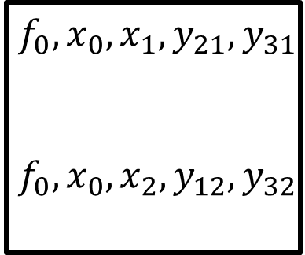

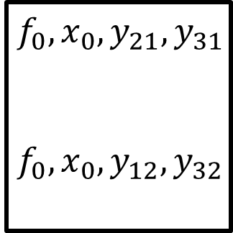




MDO: Solver Setup
Simplified Single Level System:
System Optimizer
Disciplinary Evaluators
$$f_{0},x_{0},x_{1},y_{21},y_{31}$$
$$f_{0},x_{0},x_{2},y_{12},y_{32}$$
$$f_{1},g_{1},y_{12},y_{13}$$
$$f_{2},g_{2},y_{21},y_{23}$$
Simplified Multilevel System:
System Optimizer
Disciplinary Evaluators
Disciplinary Optimizers
$$f_{0},x_{0},y_{21},y_{31}$$
$$f_{0},x_{0},y_{12},y_{32}$$
$$f_{1},g_{1},y_{12},y_{13}$$
$$x_{1},d_{1}$$
$$x_{2},d_{2}$$
$$f_{2},g_{2},y_{21},y_{23}$$
Terminology, diagrams originally from [1]
Notes:
This is a simplified diagram of what these systems may look like
In these diagrams the variables in the boxes represent information calculated by that system and arrows represent the flow of that information. The arrows don’t necessarily indicate the order these steps happen in
Both methods call a disciplinary evaluator to determine the value of the constraint functions and update coupling variables accordingly, but the big difference here is that the disciplinary optimizer in the multilevel approach is responsible for disciplinary objective and constraint updates, leaving the disciplinary evaluator only updating disciplinary variables and discrepancies

Slide 10
MDO: Solver Terminology
Simultaneous Analysis and Design (SAND)
A system optimizer determines the system, disciplinary and coupling variables all at once
Nested Analysis and Design (NAND)
Limits system optimizers to only finding disciplinary variables, including an analyzer to find coupling variables
Terminology, diagrams originally from [1]
Notes:
Now we need to talk about how the variables themselves are optimized
SAND, the first approach, uses a top level system optimizer to solve for all the variables at once across every discipline, invoking evaluators as necessary afterwards.
By contrast NAND uses disciplinary optimizers to solve for the disciplinary variables and invokes analyzers to update the coupling variables
We can choose SAND vs NAND for both system and discipline level variables
The simplified systems on the previous slide used SAND for both system and discipline variables

Slide 11

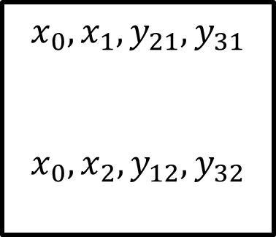

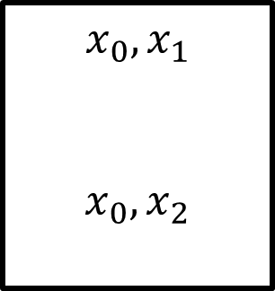




MDO: Solver Setup
Simplified Single Level SAND/SAND System:
System Optimizer
Disciplinary Evaluators
$$x_{0},x_{1},y_{21},y_{31}$$
$$x_{0},x_{2},y_{12},y_{32}$$
$$f_{1},g_{1}{,d}_{1}$$
$$f_{2},g_{2},d_{2}$$
Simplified Single Level NAND/NAND System:
System Optimizer
System Analyzer
Disciplinary Analyzers
$$x_{0},x_{1}$$
$$x_{0},x_{2}$$
$$y_{21},y_{31}$$
$$f_{1},g_{1},y_{12},y_{13}$$
$$y_{12},y_{32}$$
$$f_{2},g_{2},y_{21},y_{23}$$
Terminology, diagrams originally from [1]
Notes:
In this example the SAND/SAND (i.e. uses simultaneous methods for both system and disciplinary variables) system optimizes everything within the system optimizer, only calling an evaluator to check constraints and calculate discrepancies
The NAND/NAND system calls analyzers to optimize the system and discipline variables separately
The one caveat to this slide is that it’s entirely possible to build system which mix these approaches, using simultaneous methods to solve system variables while using nested methods to solve disciplinary variables or vice versa

Slide 12
MDO: Solver Comparison
Why should you choose one approach over another?
Single vs Multilevel
Multilevel approaches are very friendly to problems with many disciplinary constraints
Single level approaches behave very well in cases with higher proportions of coupling variables
SAND vs NAND (for either design or system)
SAND approaches are easier to set up but scale poorly, increasing the number of variables to be optimized and constraints to be satisfied by the optimizer
There is no right answer!
Notes:
An incredibly important question at this point is: what are the advantages of one approach over another and how do I know which to use?
Single level optimization schemes tend to work better in smaller problems or when there are many coupling variables compared to disciplinary variables, while multilevel schemes may be easier to implement for systems with many disciplinary constraints
Simultaneous Optimizers are easier to build in many cases but often scale poorly as new disciplines and variables are included in the problem
Overall, the main takeaway is that there is no one size fits all answer. You have to weigh each part of the problem to determine what the best approach is – and speaking from experience being willing to experiment and vary your approach will often yield the best results.

Slide 13




MDO: Constraints
Optimizing across multiple disciplines means satisfying a set of disparate constraints
Feasible regions of the state space aren’t always obvious and local minima may exist
What happens if we let the algorithm violate some of its constraints when searching for an answer?
Infeasible Region
True Optimum
Infeasible Region
Constraint $g_{j}$
Objective $f_{0}$
Current
Guess
Design Variable $x_{0}$
Design Variable $x_{0}$
Notes:
However, we do run into a couple problems – one of the more obvious being that having many disciplines with disparate constraints can often make finding a true optimum difficult. It’s entirely possible to initialize your optimizer in such a way that it settles on a local minima defined by the constraints when another feasible answer may actually be better. To that end, what would happen if we let our optimizer violate constraints during the optimization process to search for these answers?

Slide 14
MDO: Constraint Relaxation
Allowing the optimizer to temporarily violate constraints can improve performance
Open Constraints are any that the optimizer is allowed to violate at some step of the process, requiring an extra convergence step at the end to make feasible
Closed Constraints are enforced at every step with no violations allowed
Notes:
Now, we can introduce our final distinction: closed and open constraints. Having an open constraint means the optimizer is allowed to violate it while searching for a solution, however this requires an additional convergence step at the end to ensure crossdiscipline feasibility in cases where you allow disciplinary variables to violate constraints and crossdiscipline consistency in cases where you allow individual disciplines to vary system parameters
Relaxing constraints creates a more robust optimizer capable of finding solutions an optimizer with only closed constraints may not be able to

Slide 15
MDO: Open Constraints
If we allow constraints to be violated how do we ensure feasible solutions?
Define a discrepancy function
L2 norm
Difference
Etc.
Final algorithm step becomes zeroing discrepancies
Because of how changes in system variables propagate to changes in disciplinary constraints there are many options for how to approach this, depending on the system at hand
Notes:
Of course, we need to discuss how to go about building the discrepancy, consistency and convergence steps if we’re going to allow open constraints.
First, we define a discrepancy function to track either how much the coupling variables have changed in a disciplinary optimizer or, equivalently, how much the disciplinary optimization has violated a constraint. Within the literature there are dozens of different functions which have been tested across many different implementations – it largely depends on how strongly you want to penalize discrepancies
Finally, we need to find a way to bring everything back into agreement and make our final design feasible. There is a lot of complexity here due to how reducing discrepancies in system variables can propagate discrepancies elsewhere in the disciplinary equations, leaving room for designers to make intelligent choices about how best to handle this. Some implementations will do this step throughout the optimization process to ensure the discrepancies never grow too large while some wait until a condition is met and then seek to minimize discrepancies.

Slide 16
MDO: Open Constraints
Solving example here

Slide 17
Sources
[1] Balling, R. J., & Sobieszczanski-Sobieski, J. (1996). Optimization of Coupled Systems - A critical overview of approaches. AIAA Journal, 34(1), 6–17. https://doi.org/10.2514/3.13015
[2]Cramer, E. J., Dennis, Jr., J. E., Frank, P. D., Lewis, R. M., & Shubin, G. R. (1994). Problem formulation for multidisciplinary optimization. SIAM Journal on Optimization, 4(4), 754–776. https://doi.org/10.1137/0804044
[3]Tosserams, S., Etman, L. F., & Rooda, J. E. (2009). A classification of methods for distributed system optimization based on formulation structure. Structural and Multidisciplinary Optimization, 39(5), 503–517. https://doi.org/10.1007/s00158-008-0347-z

